Slide 1
Sprint 4 Presentation
By Connor Przelomski, Vincent Loretta, and Moises Pomales

Slide 2

Challenges We Faced
The biggest obstacle we faced was improvising with the limited materials and environments that we had to allow the robot to complete each sprint
Uneven flooring
Understanding how the robot moves so that we could take in to account how much the robot drifts when going through each sprint
Understanding the gantt chart

Slide 3
Roles of each team member
Name | Role | Responsibility | Reports to
Connor Przelomski | Project Manager/SDD Author | Oversees the project Writes the SDD and verifies that it is as coherent as possible | Gil Eckert (Professor/Instructor)
Vincent Loretta | Lead Programmer | Writes the code in which the robot will obey Responsible for video recording the robot’s movement | Project Manager
Moises Pomales | Lead Scheduling Coordinator | Flowchart designer Gantt chart writer Confirms whether or not the group is staying on schedule | Project Manager

Slide 4
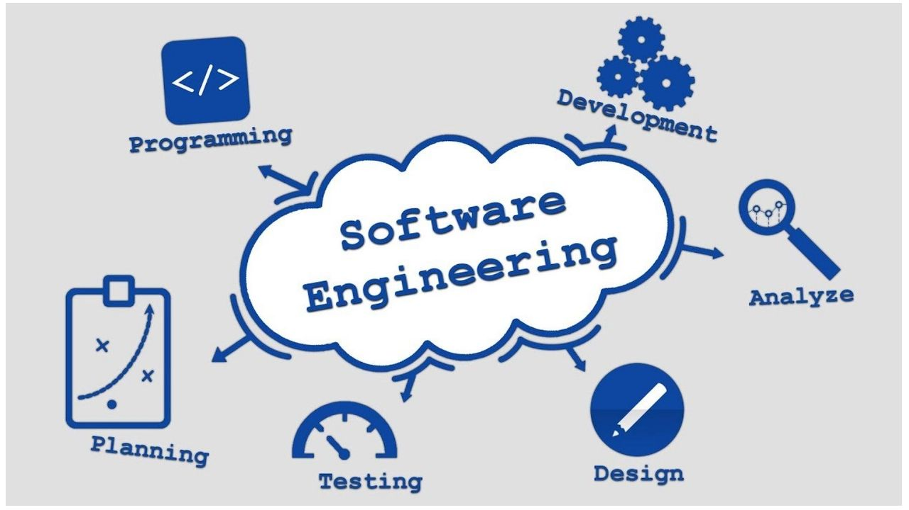
What we’ve learned about software engineering
The testing phase is more important than we realized
Planning beforehand saves a significant chunk of time
Working together as a team is the most important aspect of Software Engineering

Slide 5

What we’d do differently
One thing we would have done differently, was getting together and working in person with the robot. This would have made the process a lot easier and would have allowed us to collaborate more efficiently.
Another thing we would have done differently is gathering in the room and used the allotted course as this would have given us structure for our code rather than working with the limited resources we had.

Slide 6
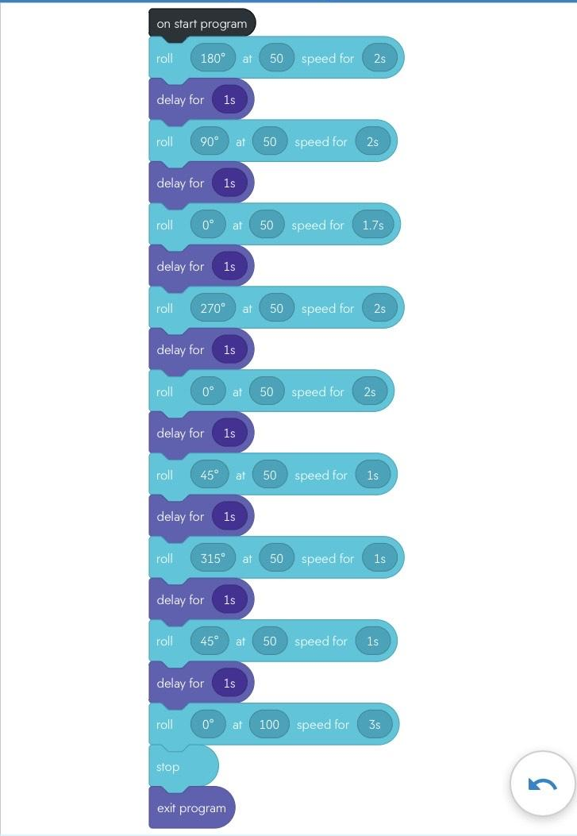
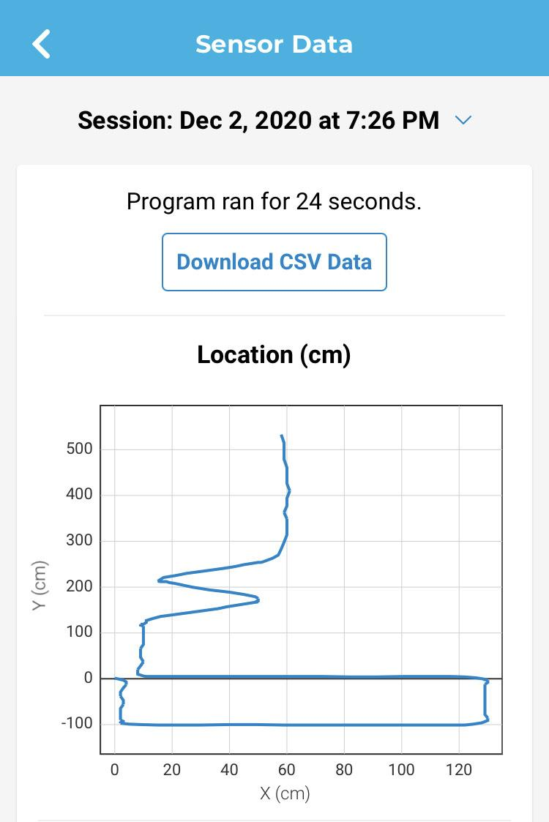

Slide 7

Agility Sprint Video

